Slide 1
Web Application Design

Slide 2
Course Objectives
Introducing the web technology
Introducing UI Languages.
Introducing Script Languages

Slide 3
Session Objective
Describe Internet services
Describe the World Wide Web
Distinguish between web applications and web sites
Server

Slide 4
Evolution of Computers
MAINFRAME
PC
CLIENT/SERVER
2-Tier
3-Tier
N-Tier

Slide 5

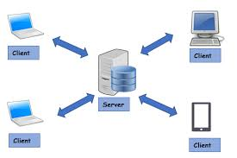
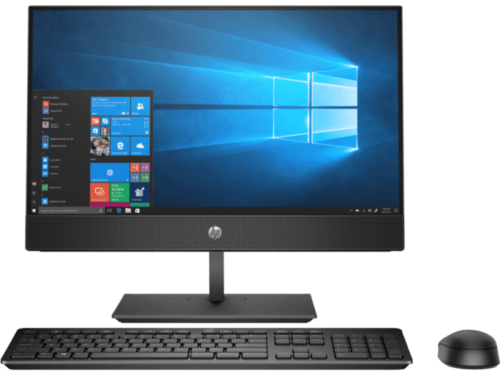
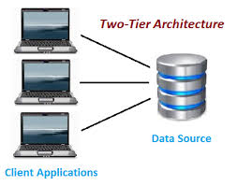
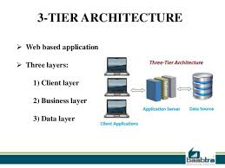
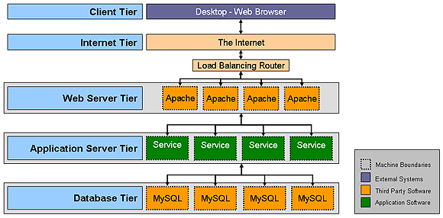
Mainframe Computers
Mainframe Computer
Personal Computer
Client Server architecture
Two-Tier Architecture
Three-Tier Architecture
N-Tier Architecture
Notes:
Main Frame:
Dump Terminals
A display monitor that has no processing capabilities. A dumb terminal is simply an output device that accepts data from the CPU
All processing/data storage on mainframe computer Large number of users Expensive
Personal Computer:
Single User System
Multi purpose system
User can develop their own application
Client Server Architecture:
Client/server architecture is a computing model in which the server hosts, delivers and manages most of the resources and services to be consumed by the client. This type of architecture has one or more client computers connected to a central server over a network or internet connection.
Two-Tier Architecture:
Three-Tier Architecture:
N-Tier Architecture:

Slide 6
Mainframe Computers

Slide 7
Mainframe Computers
Dump Terminals
A display monitor that has no processing capabilities. A dumb terminal is simply an output device that accepts data from the CPU
All processing/data storage on mainframe computer
Large number of users
Expensive

Slide 8
Personal Computers

Slide 9
Personal Computers
Single User System
Multi purpose system
User can develop their own application

Slide 10
Evolution of Client/Server architecture

Slide 11
Client/Server architecture
Client/server architecture is a computing model in which the server hosts, delivers and manages most of the resources and services to be consumed by the client. This type of architecture has one or more client computers connected to a central server over a network or internet connection.

Slide 12
Two-tier architecture

Slide 13
Three-tier architecture

Slide 14
Three-tier architecture

Slide 15
Evolution of Computers
Mainframe Computer
Personal Computer
Client Server architecture
Two-Tier Architecture
Three-Tier Architecture
N-Tier Architecture
Notes:
Main Frame:
Dump Terminals
A display monitor that has no processing capabilities. A dumb terminal is simply an output device that accepts data from the CPU
All processing/data storage on mainframe computer Large number of users Expensive
Personal Computer:
Single User System
Multi purpose system
User can develop their own application
Client Server Architecture:
Client/server architecture is a computing model in which the server hosts, delivers and manages most of the resources and services to be consumed by the client. This type of architecture has one or more client computers connected to a central server over a network or internet connection.
Two-Tier Architecture:
Three-Tier Architecture:
N-Tier Architecture:

Slide 16
Web Application
A web application is a software application that runs on a remote server.
Web browsers are used to access Web applications, over a network, such as the Internet.
(ex: Facebook, Gmail etc..)

Slide 17
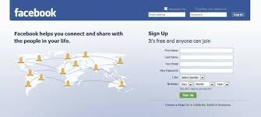
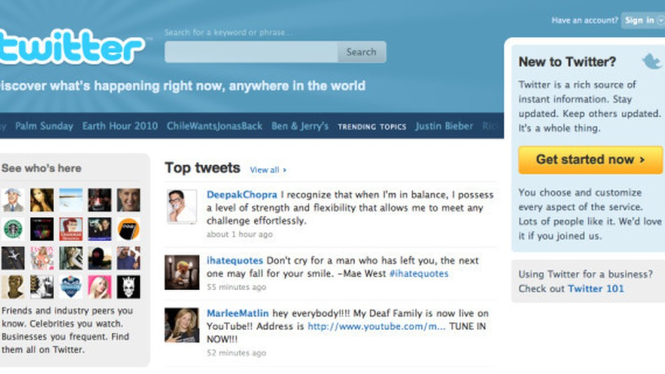
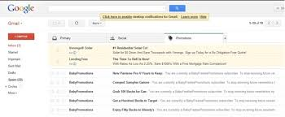
Web Applications

Slide 18
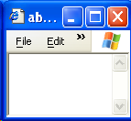
Web Application work flow
2, Web Server
1. User Request
retrieving
requested static
The
web page
Internet
File
3. Reply
System
Web
Server

Slide 19
Hypertext Transfer Protocol
Hyper Text Transfer Protocol or HTTP is the protocol used by the world wide web
The Hypertext Transfer Protocol (HTTP) supports serving up documents in the Hypertext Markup Language (HTML):
HTML documents include links to other web documents.
Web documents can also include forms to pass data from the user to the web server.
HTTP can serve any type of document.
The Multipurpose Internet Mail Extensions (MIME) specification defines a canonical naming convention for documents of various media.

Slide 20
HTTP Request
The following is the request generated by Internet Explorer when the URL was http://www.yahoo.com
HTTP Method
Request-URI
Protocol version
GET http://www.yahoo.com/ HTTP/1.0
Accept: image/gif, image/x-xbitmap, image/jpeg, application/vnd.ms-excel, application/vnd.ms-powerpoint, application/msword,application/x-shockwave-flash, */*
Accept-Language: en-us
User-Agent: Mozilla/4.0(compatible; MSIE 6.0; Windows NT 5.1)
Host: www.yahoo.com
Header

Slide 21
HTTP Response
The server processes the request and sends a Response
The following is an example of a response
Status Line
HTTP/1.1 200 OK
Date: Sat, 18 Mar 2000 20:35:35 GMT
Server: Apache/1.3.9 (Unix)
Last-Modified: Wed, 20 May 1998 14:59:42 GMT
Content-Length: 2000
Content-Type: text/html
<HTML><HEAD> </HEAD> <BODY>
…
</BODY> </HTML>
Header
Message Body -Actual Data

Slide 22
Http protocol methods
Http Methods
Get
Post
Get is the default method
The GET method means retrieve whatever information
(in the form of an entity) is identified by the Request-URI
Get Method is Idempotent
Get method carry only 266 characters at a time
In post method Data is not Visible
You can send huge amount of data through post method

Slide 23
Static Page Vs Dynamic Page
From the web, we get static pages as well as dynamic pages
Static Page | Dynamic Page
Can be created and stored in web server in advance as HTML file. | Can NOT be created and stored in web server in advance as HTML file.
Static page does not change with user and/or time. | Dynamic page changes as per the user and/or time.
For delivery of static page, all we require at server side, HTML files in Web Server. | For delivery of dynamic page, apart from Web Server, we require program to generate dynamic content.
The software component that runs the server side program to generate the dynamic content is known as the Web Container

Slide 24
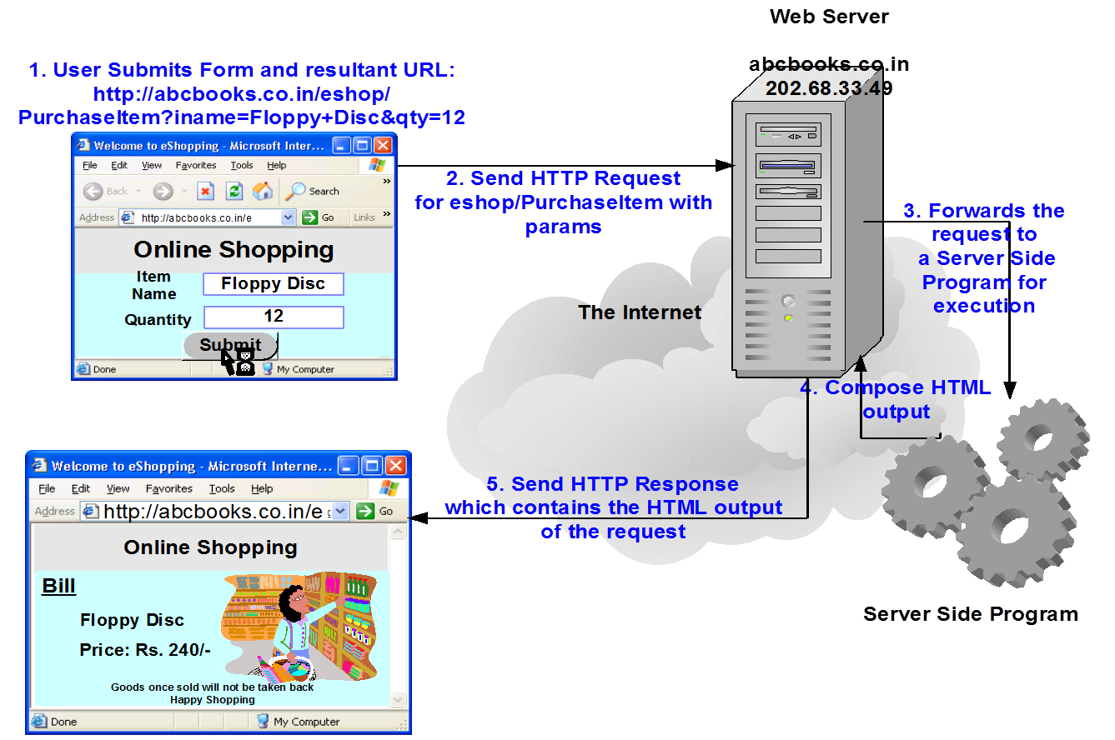
Generation of Dynamic Pages

Slide 25
Packet Travel - Video
https://www.youtube.com/watch?v=O7CuFlM4V54

Slide 26
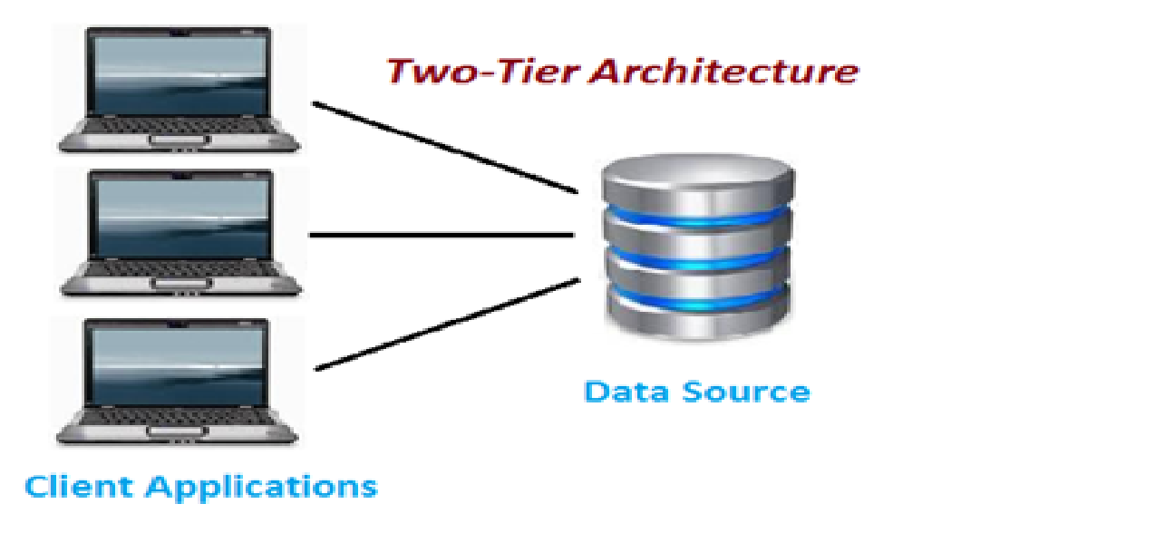
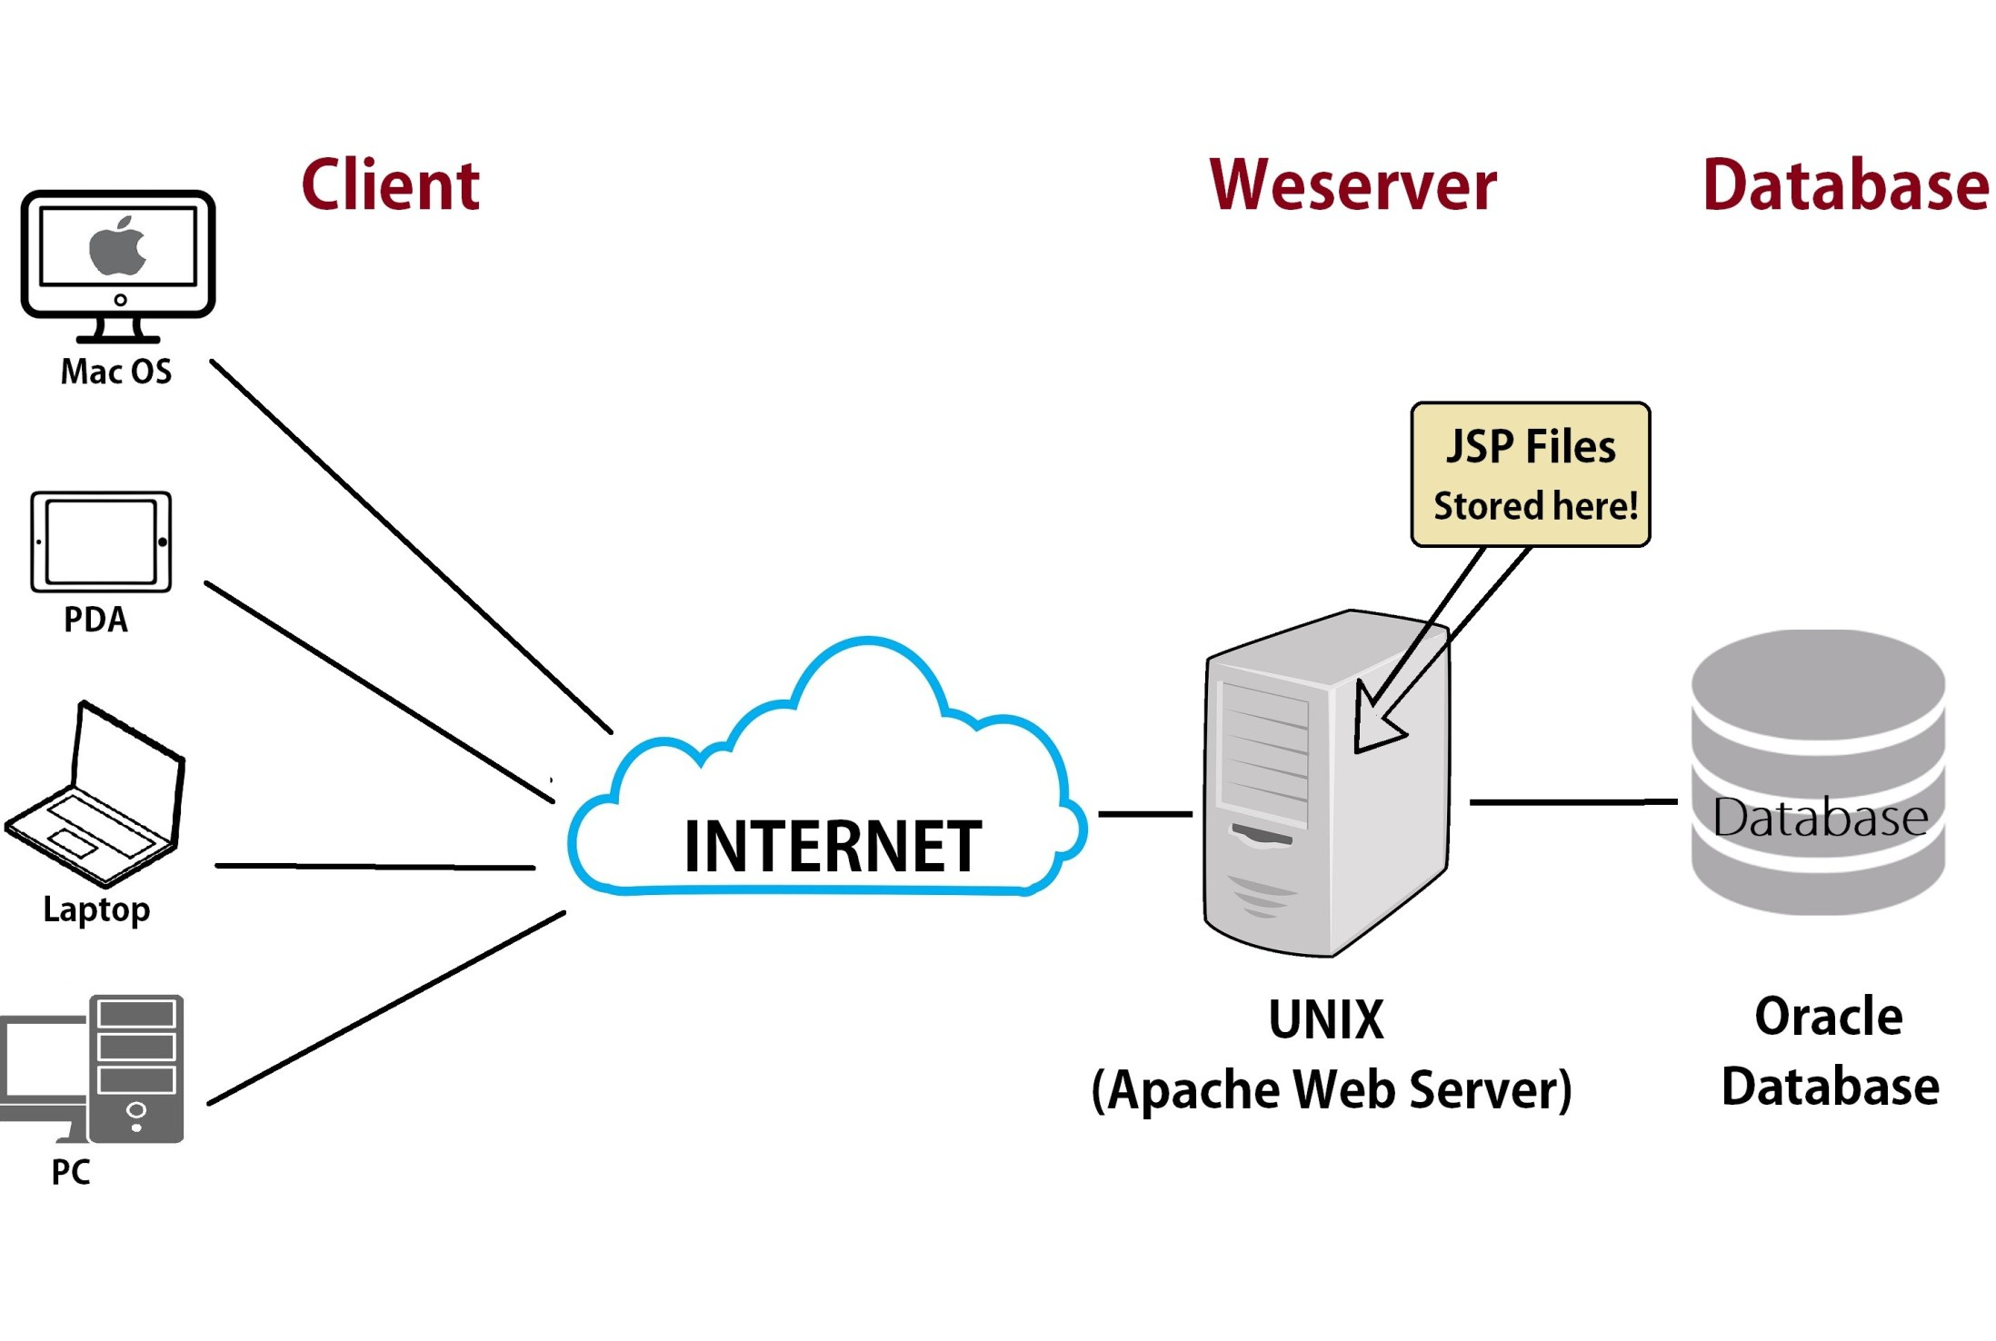
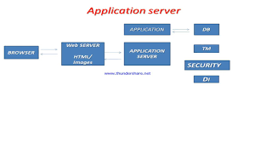
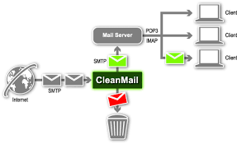
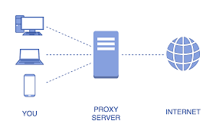
Types of servers
Database Server
Web Server
Application Server
Mail Server
Proxy Server

Slide 27
Web Services

Slide 28
Web Service
Web service is a technology to communicate one programming language with another.
Web service provides a way to achieve interoperability.
For example:
Java programming language can interact with PHP and .Net by using web services.

Slide 29
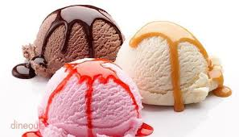



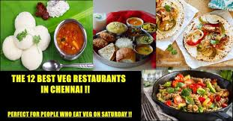

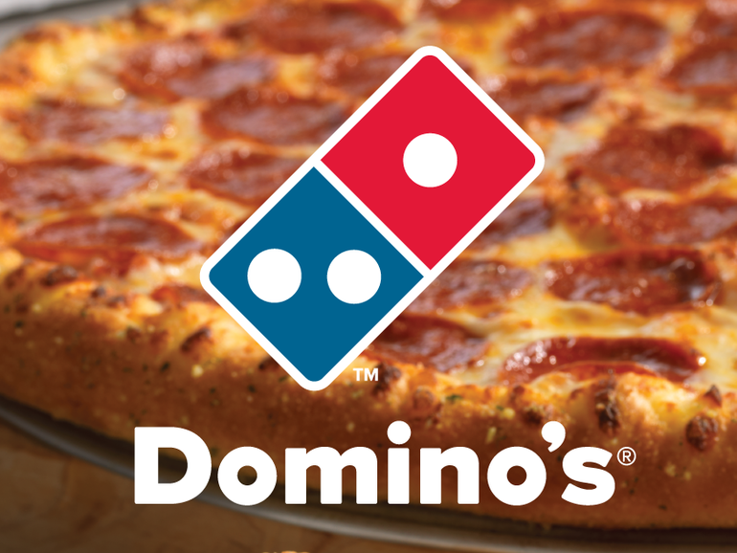

Slide 30
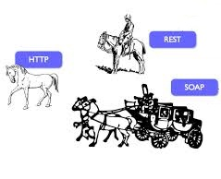
Types of Web Services
Rides directly on HTTP. Plain and simple.
There are mainly two types of web services
SOAP web services.
RESTful web services.
The coach is the soap. It wraps the data to be carried.

Slide 31

SOAP Vs REST
No. | SOAP | REST
1) | SOAP is a protocol. | REST is an architectural style.
2) | SOAP stands for Simple Object Access Protocol. | REST stands for REpresentational State Transfer.
3) | JAX-WS is the java API for SOAP web services. | JAX-RS is the java API for RESTful web services.
4) | SOAP permits XML data format only. | REST permits different data format such as Plain text, HTML, XML, JSON etc.

Slide 32
SOAP Vs REST
No. | SOAP | REST
1) | SOAP OverHead with its Head body and other Info. | REST will pass only the data
2) | In SOAP it is easy to specify the contracts using xsd and wsdl | In REST it is possible from wsdl 2.0 (supporting for mobile application)
3) | SOAP will follow the WS – standards(security ,Transaction Management etc..) | You have to develop your own code for non functional requirements
4) | SOAP permits XML data format only. | REST permits different data format such as Plain text, HTML, XML, JSON etc.

